Slide 1

Abstract Expressionism
and
Color Field Painting
Color Field

Slide 2
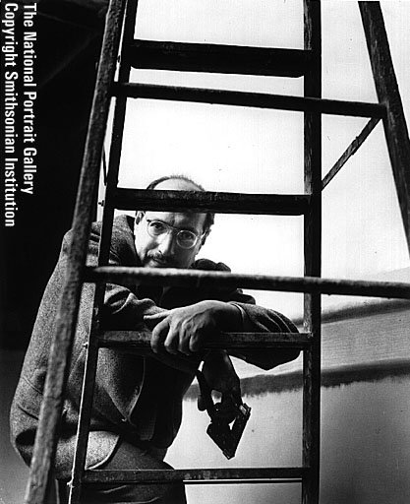
Mark Rothko
Notes:
Sometimes the term "action painting" is used to describe artists such as Pollock and de Kooning in contrast to artists making more quiet contemplative artworks. Many of these quieter works fall into the category of color field paintings such as those made by Mark Rothko.

Slide 3
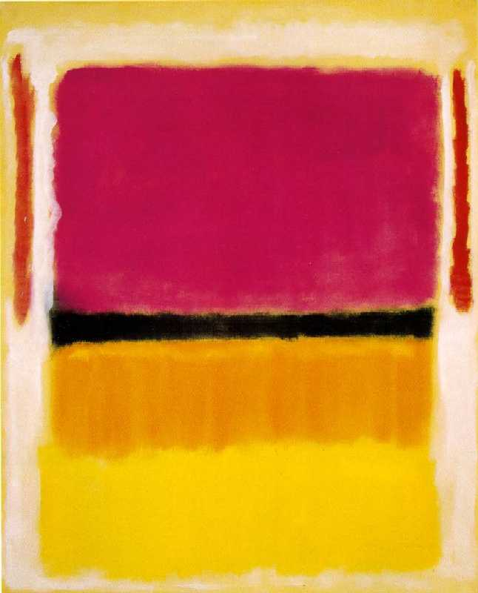
Notes:
Here we see a painting which, like Pollock's and DeKooning's, could be described as an "all over painting" in that there is no area of the canvas that is less important than any other. However instead of containing the expressive lines and brushstrokes of the action painters these paintings create a mood by using large fields of washed color.

Slide 4
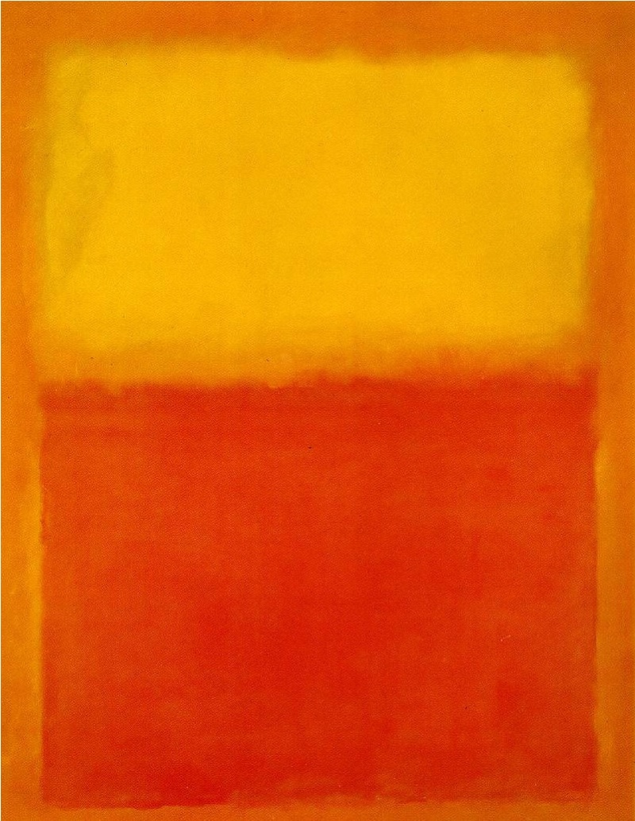
Notes:
These paintings often create a quiet and introspective feeling, as even the edges between color fields in a Rothko are softened and blurry. The mood that these paintings evoke often has a direct relationship to the colors used. Just compare the bright and energetic feeling elicited by this yellow and orange painting...

Slide 5
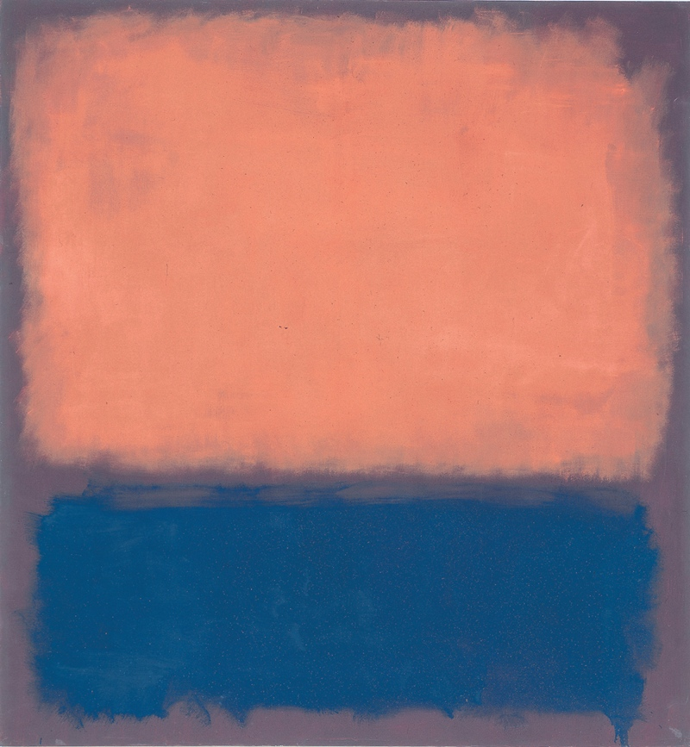
Notes:
...To the calmer and more subdued feeling found in this darker pink and blue and purple one.

Slide 6
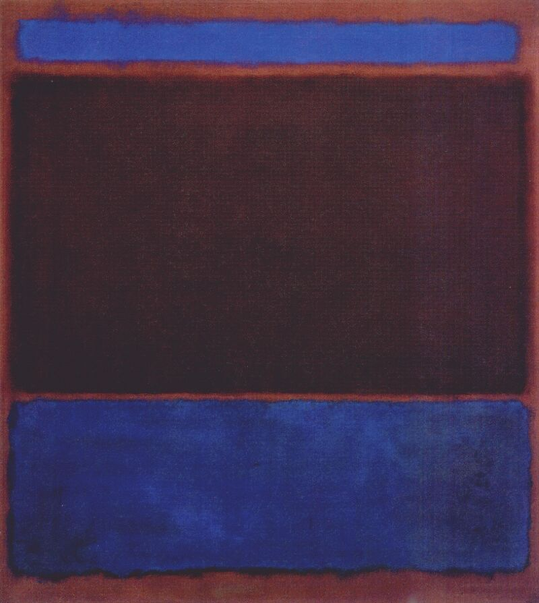
Notes:
Rothko's paintings often create a feeling of environment that surrounds the viewer. To experience these paintings you must be in front of them to encounter just how large they are. Often a series of paintings were made that function together. They would be hung altogether in a room surrounding the viewer. People often talk about the spiritual experience of encountering a Rothko.

Slide 7
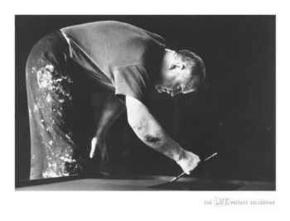
Ad Reinhardt
Notes:
Ad Reinhardt was also interested in creating paintings that required a calm set of eyes to view.

Slide 8
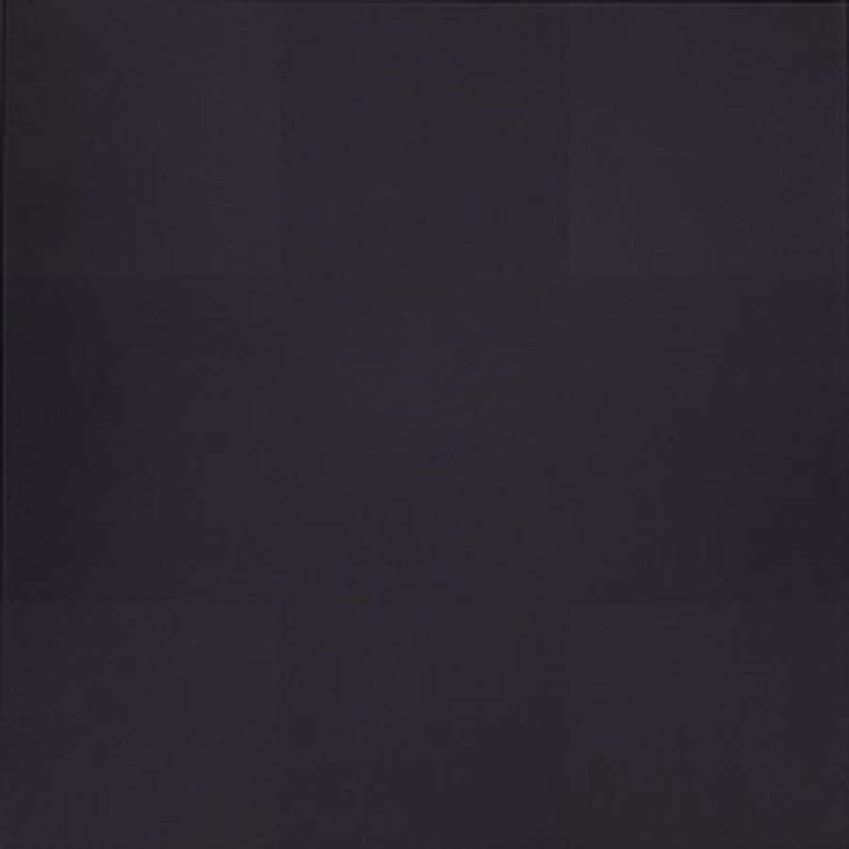
Notes:
He coined the term "zero point" to describe paintings that required the eyes to adjust in order to see the image. If you stare closely at one of Reinhardt's black paintings, you begin to see a cross shape filling the center of the canvas. Reinhardt prided himself in making paintings that were almost impossible to photograph, the image in front of you doesn't even come close to the real thing. The blacks that he lays next to each other are so close in color that one must concentrate on them for a long time before any image is even visible.

Slide 9
Abstract Expressionism
and
Color Field Painting
Second Generation
Notes:
Younger artists who join the abstract Expressionism movement were often referred to as the second-generation abstract expressionists.

Slide 10
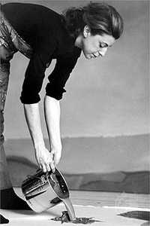
Helen Frankenthaler
Notes:
Helen Frankenthaler was one of these. Her technique of pouring paint directly onto a canvas inspired many other Abex painters.

Slide 11
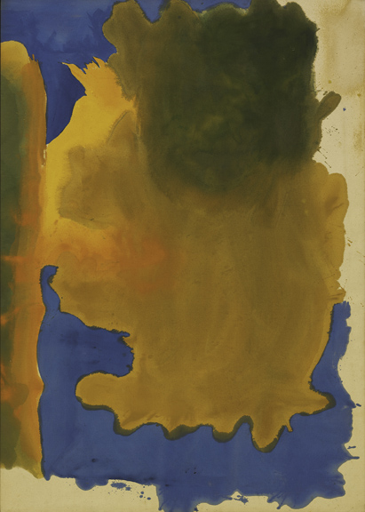
Notes:
Here we can see how the paint once poured directly onto the canvas has been move moved around and manipulated with brushes. This could also be referred to as a color field painting, but compared to a Rothko or Reinhardt, the shapes are more flowing and organic.

Slide 12
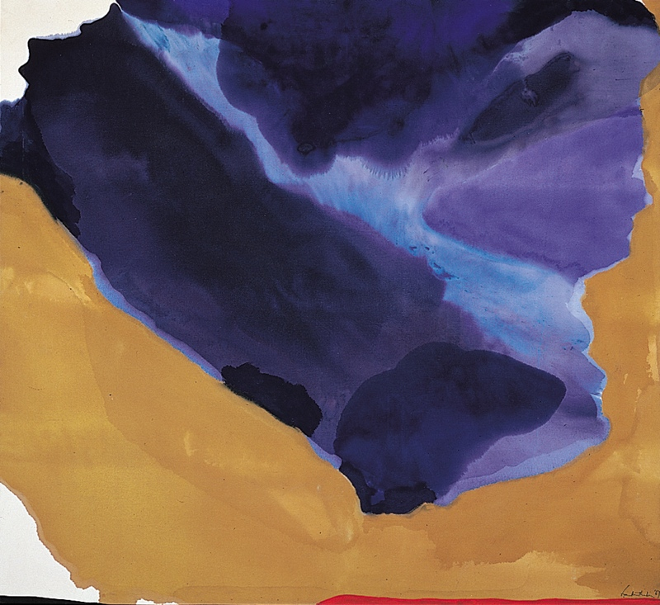
Notes:
Frankenthaler achieved an almost watercolor affects by thinning her paints down and applying them in several overlapping washes of color.

Slide 13
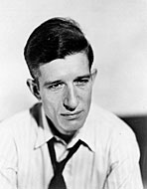
Morris Louis
Notes:
Morris Louis was influenced greatly by Frankenthaler's techniques.

Slide 14
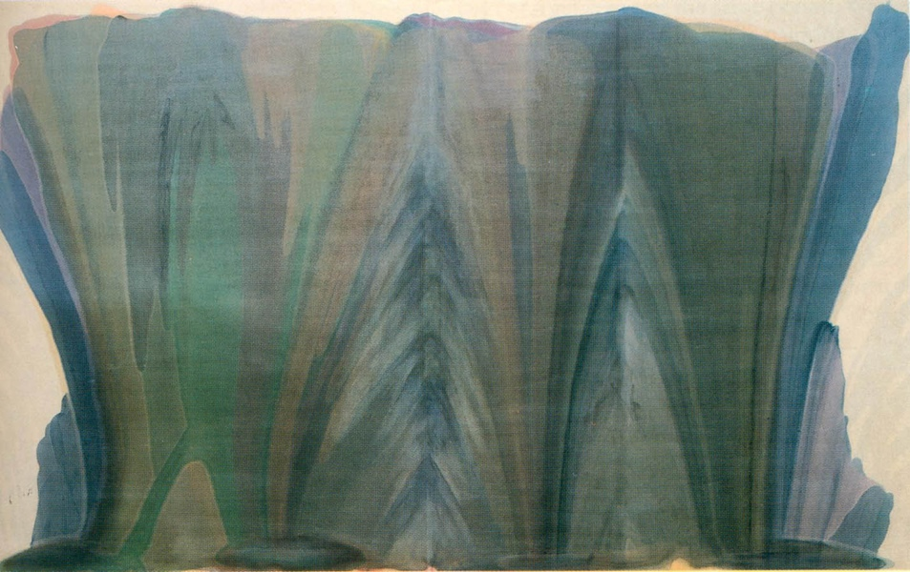
Notes:
His veil paintings, so called because they look like tranparent veils, achieve a similar transparency through thin washes of paint which were poured down the surface of the canvas. In this vale painting we can see the direction of the paint pours moves from the bottom of the canvas towards the top and has been divided into several sections.

Slide 15
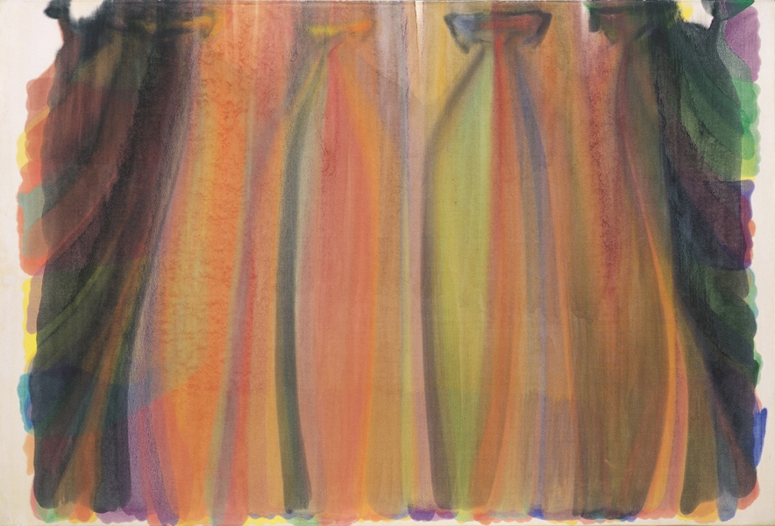
Notes:
In this one we see the poured paint starting from the top and spilling down towards the bottom and the sides.

Slide 16
Images:
Marc Rothko
Voilet, Black, Orange, Yellow on White and Red, 1949
Orange and Yellow, 1957
Number 14, 1961
Bright Blue, Brown, Dark Blue on Wine, 1962
Helen Frankenthaler
Canal 1963: acrylic on canvas
Bay Side, 1967. Acrylic on canvas
Morris Louis
Tet. 1958. Synthetic polymer on canvas
Saraband, 1959. Acrylic resin on canvas
Notes:
Venus of Hohle Fels, 35-40,000 years old, Mamoth Ivory, GermanyVenus of Willendorf, 24-26,000 years old, limestoneLascaux Caves, 16 thousand years old, France Venus of Hohle Fels, 35-40,000 years old, Mamoth Ivory, GermanyVenus of Willendorf, 24-26,000 years old, limestoneLascaux Caves, 16 thousand years old, FranceKing Mycerinus and Wife, 4,500 years old, EgyptDiscobolus, 2,500 years old, GreeceLeonardo Da Vinci, Madonna and Child with a Pomegranate, 1469, ItalyMichelangelo, David, 1501-1504, ItalyEdward Monet, Haystacks, 1891, FrancePablo Picasso, Vollard, 1910, FranceEl Lissitzky, Proun 12E, 1923, RussiaPiet Mondrian, Composition in Red, Yellow, Blue, 1931Joseph Albers, Homage to the Square, 1950Jackson Pollock, Lavender Mist, 1950, New York

